Slide 1
Applied Data Science 2
Dr Ashley SpindLer
Semester A, 2022

Slide 2
Lecture 4 - Outcomes
Learn about the core concepts behind the Keras Machine Learning API
Understand the principles of computer vision
Examine how convolutional layers function to process image data

Slide 3

Keras – A Deep Learning API
Simple -- but not simplistic. Keras reduces developer cognitive load to free you to focus on the parts of the problem that really matter.
Flexible -- Keras adopts the principle of progressive disclosure of complexity: simple workflows should be quick and easy, while arbitrarily advanced workflows should be possible via a clear path that builds upon what you've already learned.
Powerful -- Keras provides industry-strength performance and scalability: it is used by organizations and companies including NASA, YouTube, or Waymo.
https://keras.io/about/

Slide 4
Keras – Layers and Models
Layers are the basic building blocks of Keras Models:
Layers operate on a Tensor-in, Tensor-out computation function
A Layer is a Class, not a Function, and stores it’s current state as tf.Variables
The Layers state is usually the weights and biases of the neurons in the layer

Slide 5
Keras – Layers and Models
Layers are the basic building blocks of Keras Models:
Layers operate on a Tensor-in, Tensor-out computation function
A Layer is a Class, not a Function, and stores it’s current state as tf.Variables
The Layers state is usually the weights and biases of the neurons in the layer
Keras Models come in two forms: Sequential and Functional Models

Slide 6
Keras – Layers and Models
Layers are the basic building blocks of Keras Models:
Layers operate on a Tensor-in, Tensor-out computation function
A Layer is a Class, not a Function, and stores it’s current state as tf.Variables
The Layers state is usually the weights and biases of the neurons in the layer
Keras Models come in two forms: Sequential and Functional Models
Sequential Models are a linear stack of layers that takes in some input and calculates some output.

Slide 7
Keras – Layers and Models
Layers are the basic building blocks of Keras Models:
Layers operate on a Tensor-in, Tensor-out computation function
A Layer is a Class, not a Function, and stores it’s current state as tf.Variables
The Layers state is usually the weights and biases of the neurons in the layer
Keras Models come in two forms: Sequential and Functional Models
Sequential Models are a linear stack of layers that takes in some input and calculates some output.
Functional Models are more complex, and allow for customisation of how the tensors are passed through the model

Slide 8
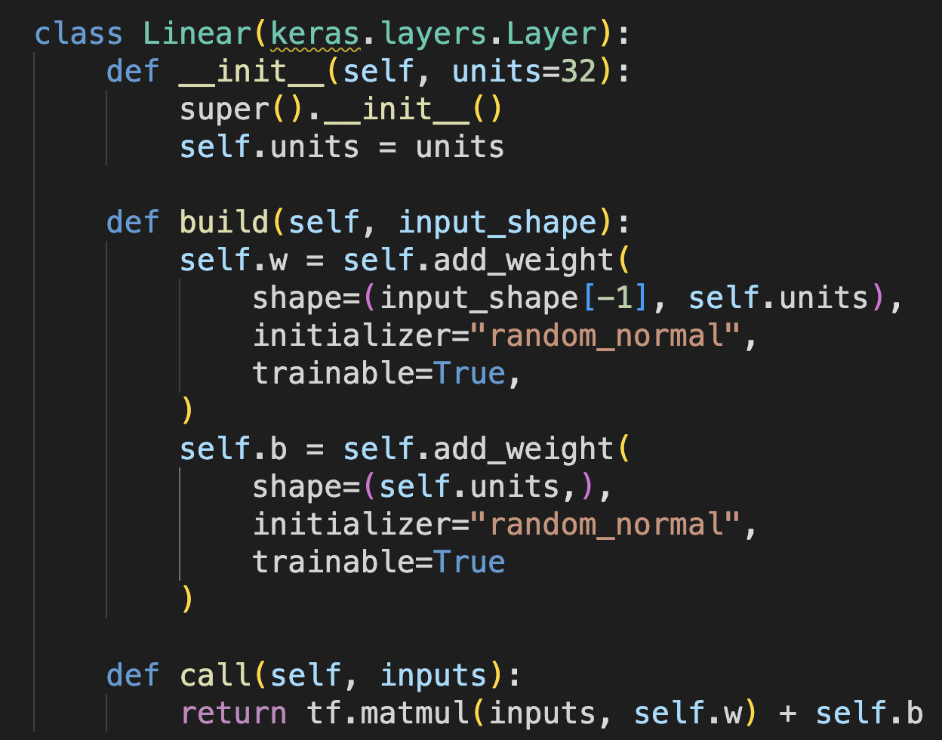
Anatomy of a Layer
This custom layer performs a weighted sum of the inputs, for a given number of units or neurons.
The __init__ method is called when the layer is first created, and sets up any important attributes for the object.
The super().__init__() call is used to inherit the properties of the parent class.

Slide 9
Anatomy of a Layer
The build method is used to add the weights to the layer. In this case the shape of the weights depends on the input shape.
build() is called automatically when the layer is first called, if it has not been built already.
This layer has a weight matrix and a bias that is added to the output, both are set to be trainable.

Slide 10
Anatomy of a Layer
The call method defines the logic of the forward pass of the layer.
The first time call is used, the layer will also call build if it has not already been built.
The method returns a tensor, in this case the dot product of the inputs and weights, plus the bias.

Slide 11
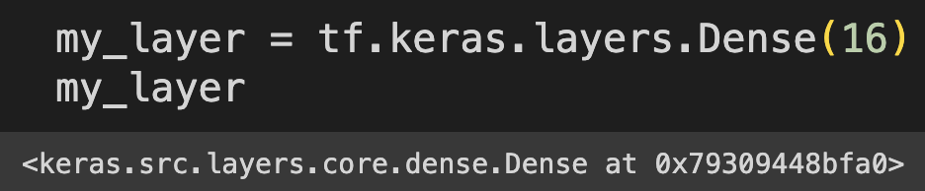
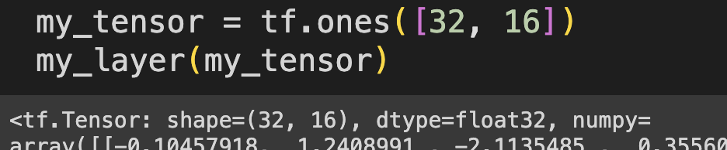
Anatomy of a Layer

Slide 12
Building a Sequential Model
Sequential Models are a linear stack of layers that takes in some input and calculates some output.
Useful when there is no need for complex connections between layers, like skip connections or multiple outputs.
Define layers inside the Sequential Class call statement.

Slide 13
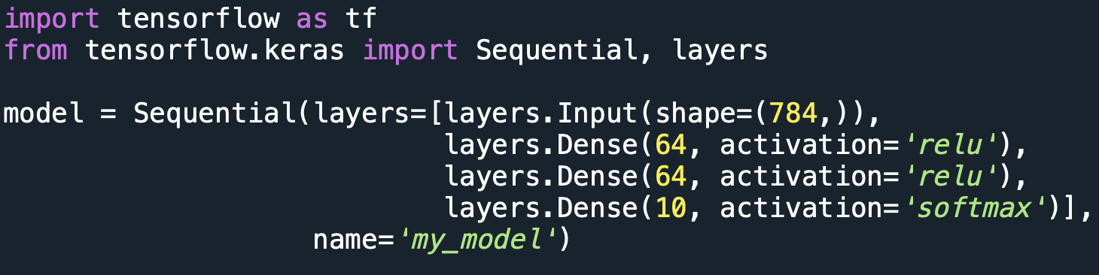
Building a Sequential Model
Sequential Models are a linear stack of layers that takes in some input and calculates some output.
Useful when there is no need for complex connections between layers, like skip connections or multiple outputs.
Define layers inside the Sequential Class call statement.

Slide 14
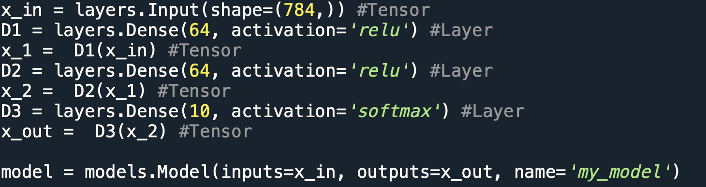
Building a Functional Model
“Functional” because layers are called like “Functions”.
Create layers independently, then pass their outputs as arguments to the next layer.
Useful for complex model architectures and accessing layers outside of a model.

Slide 15
Why Keras Models?
The benefit of using keras models is that they predefine many of the utility functions and methods we need to train a neural network.
There is no need to write a custom training loops, or define how to perform the backpropagation of gradients through the model.
Built-in methods handle all the heavy lifting, letting us get on with training and analyzing our models.

Slide 16
(Almost) All Models Work the Same
Compile models to set the learning algorithm, loss functions and metrics:
Model.compile(optimizer=…, loss=…, metrics=[…])
Train models using the fit method, specify the training data, batch size and number of epochs:
Model.fit(x=x_train, y=y_train, batch_size=32, epochs=50)
Calculate the outputs of a trained model using the predict method:
y_pred = Model.predict(x=x_test, …)
Calculate the losses and metrics of a trained model using the evaluate method:
loss, metrics = Model.evaluate(x=x_test, …)

Slide 17
Save and Load Trained Models
Saving and loading weights:
Model.save_weights(‘/path/to/file’)
Model.load_weights(‘/path/to/file’)
When loading weights, you need to define the model in the code, as you would when training the model from scratch.
Saving and loading models:
Model.save(‘/path/to/file’)
tf.keras.load_model(’/path/to/file’)
Saving and loading the entire model means you don’t need to redfine the model in the code, however this can be tricky with custom layers and functions.

Slide 18
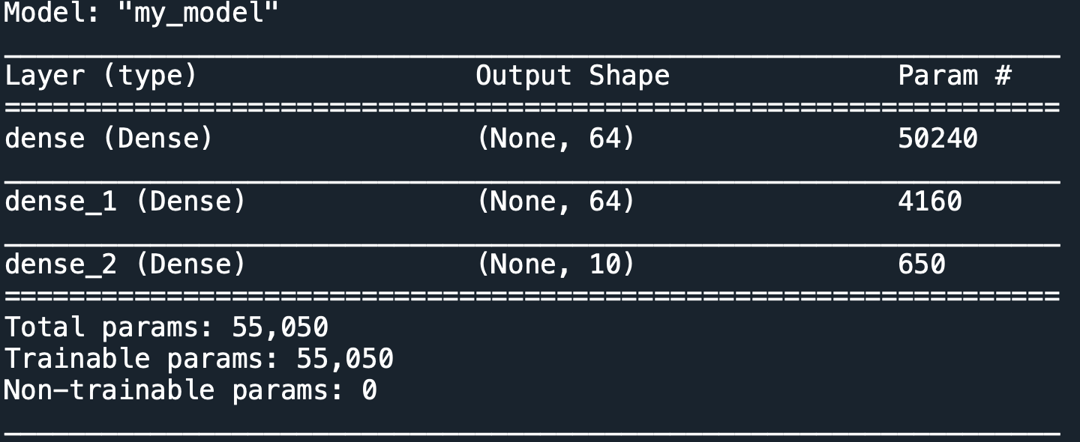
Other Useful Tools
Print a summary of the model and its layers:
Model.summary()
Access the layers of a model as a list of individually:
Model.layers # returns an indexable list of layers
Model.get_layer(name=None, index=None) # returns a layer based on the name or index provided

Slide 19
There is No One Size Fits All
When it comes to building neural networks, there is no one sets of layers or settings you should always use.
Every dataset and problem has its own unique properties, and a model that works for one problem might not work for another.
The key to developing good machine learning models is to EXPERIMENT. Change settings, add or take away layers, alter training times.
Throughout this module you will see some of the best practice when it comes to designing neural networks, but these are only starting points.
Always review the results of a model and see if they can be improved. Question the inclusion of layers, or the use of particular activation functions.
DO NOT just copy and paste models from one problem to the next and expect them to work.

Slide 20
Common Questions
What layers should I use?
Start with well-known models, then modify—more layers=more complexity, but harder to train. Sometimes fewer layers=better result.
How long should I train for?
Until the training loss stops improving. If the training loss is still proving, train the model for more epochs.
What loss function should I use?
Depends on the problem at hand. Binary classification should use binary crossentropy, multi-class problems can use (sparse) categorical crossentropy. Real value prediction can use Mean Squared Error.
What compiler should I use?
When in doubt, use Adam. Try a range of learning rates and see what produced the best result.

Slide 21
Keras Demo

Slide 22
Questions???

